Slide 1
Introduction to .NET
Frank McCown
COMP 445 - GUI Programming
Harding University

Slide 2
Programming Windows Before .NET
1985: Windows 1.0 – Win API
1991: Visual Basic
1992: Windows 3.1 – Win16 API
1992: Microsoft Foundation Classes (MFC)
1993: Windows NT and 95 – Win32 API
1995: Java – “Write once, run anywhere.”
1996?: Embrace and extend: Visual J++
Notes:
MS stopped supporting VB in 2005.
“Write once, test everywhere.” – Hooks to OS or hardware specific devices means Java code must be changed.
Visual J++ was Java with Microsoft hooks. Sun sued MS over the changes to Java and eventually settled for hundreds of millions of dollars. Also J++ could no longer be worked on. Later recycled as J# in .NET.

Slide 3
.NET Framework
First developed by Microsoft in 2000
Current version (4.0) released in Apr 2010 with Visual Studio .NET 2010
Targets primarily Windows OS, but Mono Project (headed by Novell) supports Linux, Unix, FreeBSD, Mac OS X, Solaris
Primary languages: C#, Visual Basic .NET, C++/CLI, and F#
Third-party languages: Ada, COBOL, LISP, Perl, Python, Ruby, and many more
Support for J# has been dropped
Notes:
C#'s principal designer and lead architect at Microsoft is Anders Hejlsberg who also developed Turbo Pascal, Borland Delphi, and Visual J++.
C++/CLI (Common Language Infrastructure) supersedes managed C++. It contains new syntax that helps clarify if using managed or unmanaged memory.
http://en.wikipedia.org/wiki/C%2B%2B/CLI
Managed vs. unmanaged code. What is the advantage of running managed code? Of running unmanaged code?

Slide 4
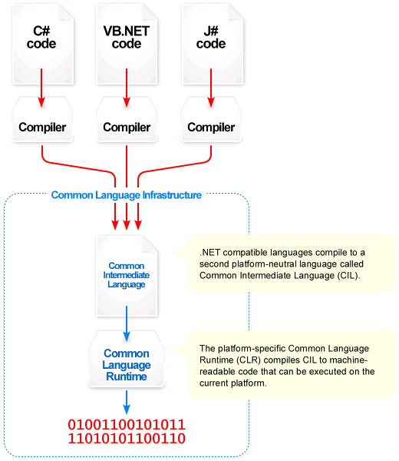
http://en.wikipedia.org/wiki/Image:Overview_of_the_Common_Language_Infrastructure.png
Notes:
CIL is also called MSIL (Microsoft Intermediate Lang)

Slide 5
Comparison to Java
Hello.java
Hello.class
JVM
compile
execute
Source code
Byte code
Hello.vb
Hello.exe
CLR
compile
execute
Source code
CIL
Notes:
Byte codes are interpreted by the JVM or JITted before being executed. CIL is JITted into object code which is executed by the CLR.

Slide 6
Hello, VB.NET!
.method public static void Main() cil managed
{
.entrypoint
.custom instance void [mscorlib]System.STAThreadAttribute::.ctor() = ( 01 00 00 00 )
// Code size 14 (0xe)
.maxstack 8
IL_0000: nop
IL_0001: ldstr "Hello VB.NET!"
IL_0006: call void [mscorlib]System.Console::WriteLine(string)
IL_000b: nop
IL_000c: nop
IL_000d: ret
} // end of method Hello::Main
Module Hello
Sub Main()
Console.WriteLine("Hello, VB.NET!")
End Sub
End Module
ildasm Hello.exe

Slide 7
Helpful Resources
Comparison of Java vs. C#
http://en.wikipedia.org/wiki/Comparison_of_C_Sharp_and_Java
http://www.harding.edu/fmccown/java1_5_csharp_comparison.html
Comparison of VB.NET vs. C#
http://en.wikipedia.org/wiki/Comparison_of_C_sharp_and_Visual_Basic_.NET
http://www.harding.edu/fmccown/vbnet_csharp_comparison.html

