Slide 1
Network Structures
Dr. Frank McCown
Web Science
Harding University
This work is licensed under a Creative Commons Attribution-NonCommercial-ShareAlike 3.0 Unported License

Slide 2
Density
How interconnected is the graph? existing edges / potential edges
density = 1
density = 0
Notes:
density - Proportion of existing edges out of all possible edges that could exist
nx.density(G)

Slide 3
Density
num of potential edges =
N(N-1)/2 for undirected N(N-1) for directed
existing edges = 5 potential edges = 5(5-1)/2 = 10 density = 5 / 10 = 0.5
A
C
E
B
D
Notes:
density - Proportion of existing edges out of all possible edges that could exist
nx.density(G)

Slide 4
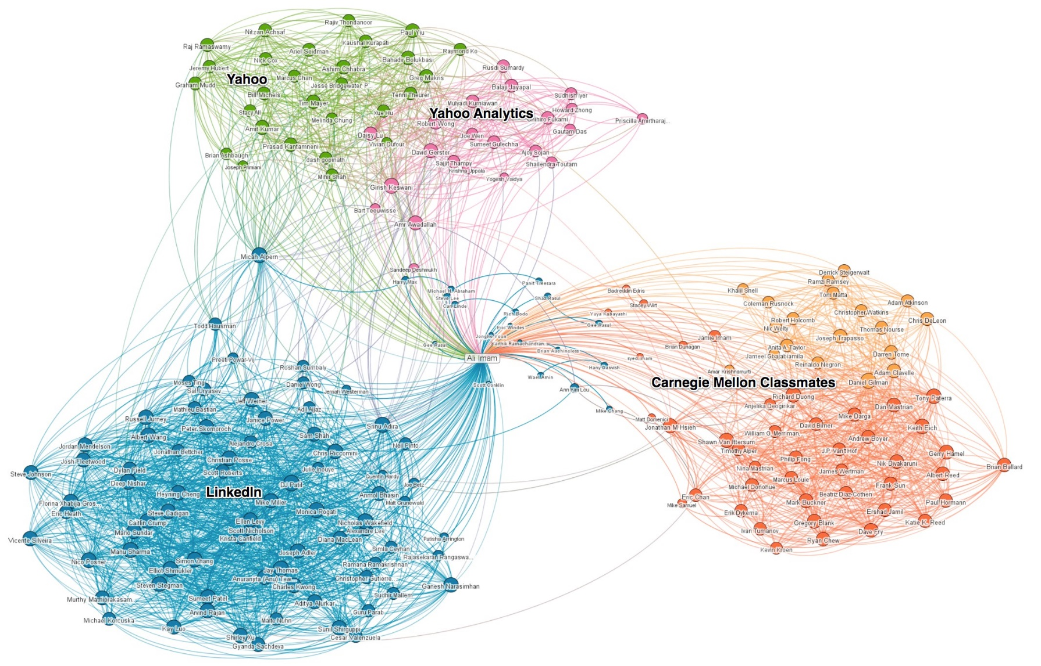
Example from LinkedIn Network
low density
high
density
LinkedIn Network (Imam, 2011)

Slide 5
Average Path Length
Mean of lengths of shortest paths between all vertex pairs
A
E
C
B
D
Notes:
average_shortest_path_length(G, weighted=False)

Slide 6
Average Path Length
A->B = 1 A->C = 1 A->D = 2 A->E = 3
B->A = 1 B->C = 1 B->D = 2 B->E = 3
C->A = 1 C->B = 1 C->D = 1 C->E = 2
D->A = 2 D->B = 2 D->C = 1 D->E = 1
E->A = 3 E->B = 3 E->C = 2 E->D = 1
34 / 20 = 1.7
A
E
C
B
D
Notes:
average_shortest_path_length(G, weighted=False)

Slide 7
Triads
Any group of 3 vertices
A
E
C
B
D

Slide 8
Triads
Example triads:
A
E
C
B
D

Slide 9
Triads
Example triads:
A
E
C
B
D

Slide 10
Triads
triangle = closed triad
A
E
C
B
D
Notes:
triangles(G)

Slide 11
Transitivity
Global transitivity: Ratio of loops of length 3 (triangles) to paths of length 2
ABC, ACB, BAC, BCA, CAB, CBA = 6
ABC, ACB, ACD, BAC, BCA, BCD, CAB, CBA, DCA, DCB = 10
6 / 10 = 0.6
A
C
triangle
B
D
Notes:
transitivity(G)

Slide 12
Transitivity
Global transitivity: Fraction of closed triads (triangles) or
mean probability that two people with a common friend are themselves friends
ABC, BAC, CAB = 3
ABC, BAC, CAB, CBD, CAD = 5
3 / 5 = 0.6
A
C
triangle
B
D
Notes:
In a social network, the transitivity coefficient corresponds to the fraction of triads that are closed, that is the fraction of pairs of people with a common friend who are themselves friends, or equivalently, the mean probability that two people with a common friend are themselves friends.
What is transitivity if add edges A-D and B-D? 1

Slide 13
Transitivity
Local transitivity or clustering coefficient: Probability that 2 adjacent vertices are connected = number of friend pairs / num of possible friend pairs
A: BC (1) / BC (1) = 1
C: AB (1) / AB, AD, BD (3) = 0.3333
A
C
B
D
Notes:
CC = 0 when none of node’s friends are friends with each other
CC = 1 when all of node’s friends are friends with each other
clustering(G, nodes=None, weight=None)
How would removing C-B edge affect C’s local transitivity?
How would adding C-D edge affect C’s local transitivity?

Slide 14
Cliques
Group of nodes where every node is connected to every other node (all triads in clique are closed)
E
A
F
C
G
B
D
Notes:
print(list(nx.find_cliques(G)))
What edges must be added to include D in the clique?

Slide 15
Bridges
A
B
Bridge – Edge that if removed creates two components

Slide 16
Local Bridges
Local bridge – Edge whose 1) endpoints have no nodes in common and 2) removal does not create new components

Slide 17
Other Helpful Resources
Easley & Kleinberg, Networks, Crowds, and Markets (2010)
Christakis and Fowler, Connected (2009)
Kadushin, Understanding Social Networks (2011)

