Slide 1
Collective Intelligence
Dr. Frank McCown
Intro to Web Science
Harding University
This work is licensed under a Creative Commons Attribution-NonCommercial-ShareAlike 3.0 Unported License

Slide 2
What is Collective Intelligence?
Human Computation
Crowd- sourcing
Social Computing
Collective Intelligence
Data Mining
Quinn and Bederson, CHI 2011

Slide 3
Collective Intelligence
“groups of individuals doing things collectively that seem intelligent.” Thomas Malone, Director of MIT Center for Collective Intelligence, 2006 http://cci.mit.edu/about/MaloneLaunchRemarks.html
“when technologists use this phrase they usually mean the combining of behavior, preferences, or ideas of a group of people to create novel insights.” Toby Segaran, Programming Collective Intelligence, 2007, p. 2

Slide 4
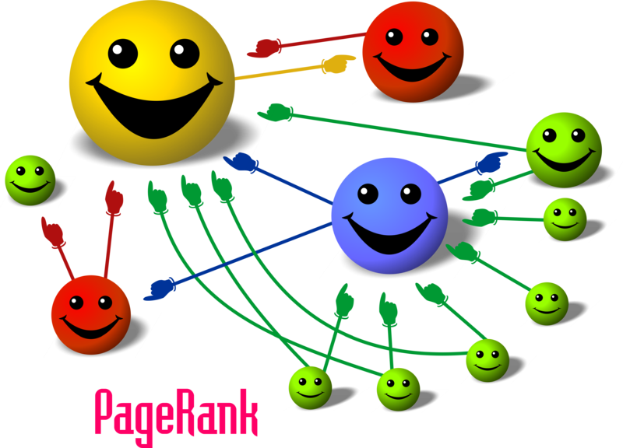
Image: http://organicseoexpert.org/wp-content/uploads/2012/03/pagerank.png

Slide 5
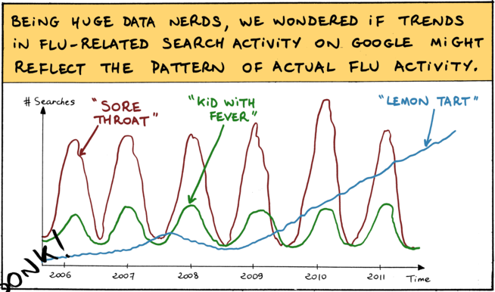
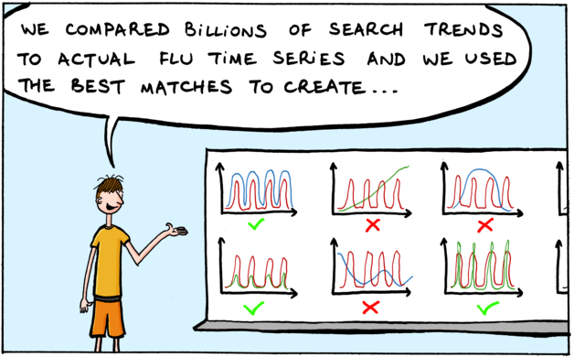
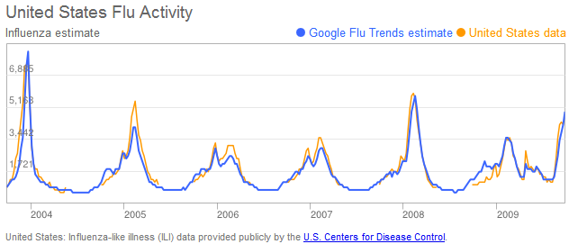
http://www.google.com/trends/correlate/comic?p=2
http://www.google.org/flutrends/about/how.html

Slide 6
Crowdsourcing
“the act of taking a job traditionally performed by a designated agent (usually an employee) and outsourcing it to an undefined, generally large group of people in the form of an open call.” Jeff Howe, “The Rise of Crowdsourcing”, Wired, Jun 2006 http://www.wired.com/wired/archive/14.06/crowds.html

Slide 7
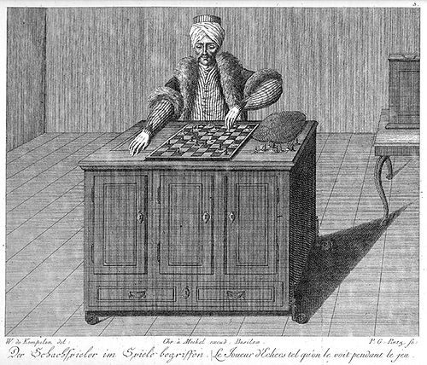
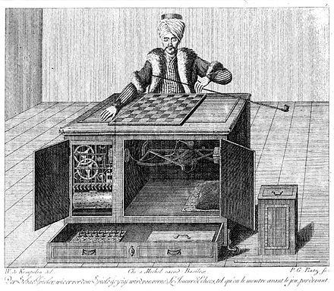
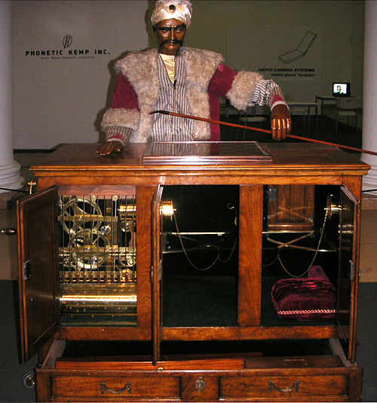
Mechanical Turk
Mechanical chess player in 18th and 19th century that is actually powered by a human
http://en.wikipedia.org/wiki/The_Turk

Slide 8
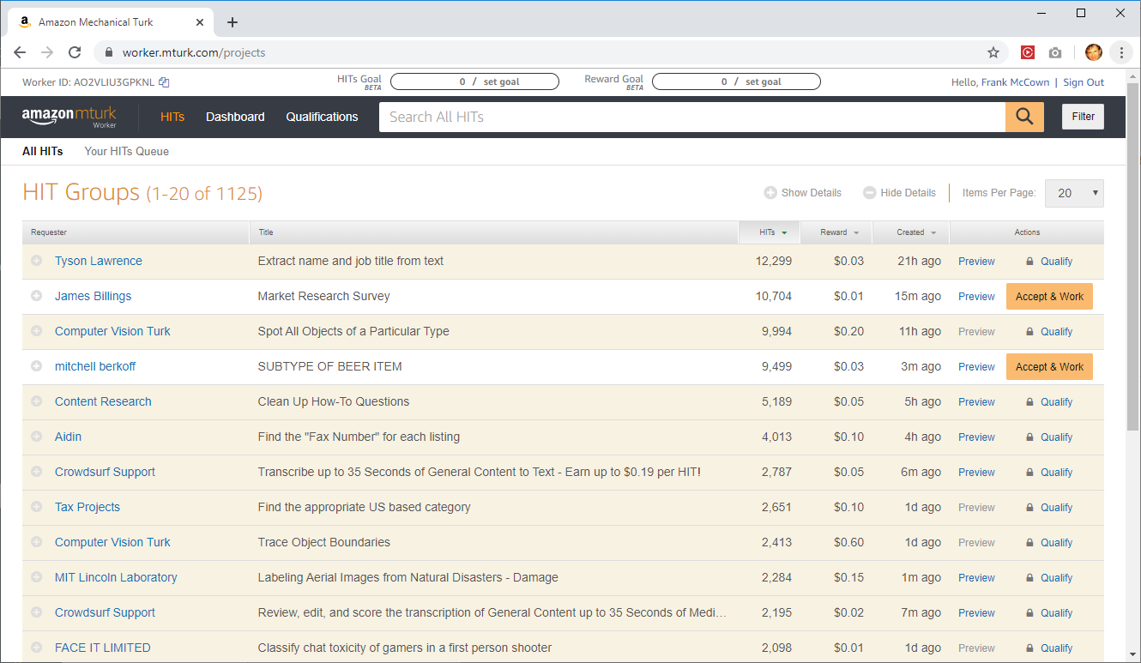
Amazon’s MTurk

Slide 9
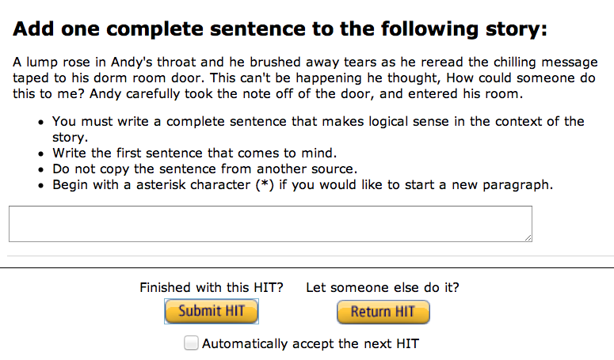
Collaborative Fiction
http://www.subelsky.com/2011/12/writing-short-horror-story-with-amazon.html

Slide 10
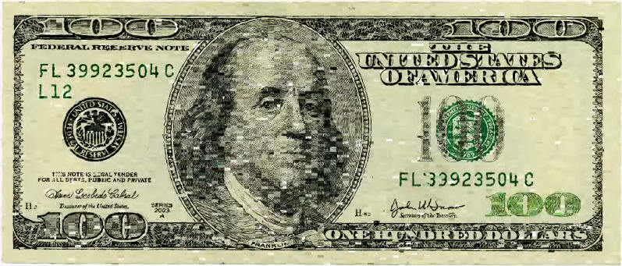
Ten Thousand Cents
"Using a custom drawing tool, thousands of individuals working in isolation from one another painted a tiny part of the bill without knowledge of the overall task. Workers were paid one cent each via Amazon's Mechanical Turk distributed labor tool.”
http://www.tenthousandcents.com/

Slide 11
Human Computation
“a paradigm for utilizing human processing power to solve problems that computers cannot yet solve.” Luis van Ahn, Doctoral Dissertation at Carnegie Mellon, 2005
“Human computation:
The problems fit the general paradigm of computation, and as such might someday be solvable by computers.
The human participation is directed by the computational system or process.” Quinn and Bedderson, CHI 2011

Slide 12
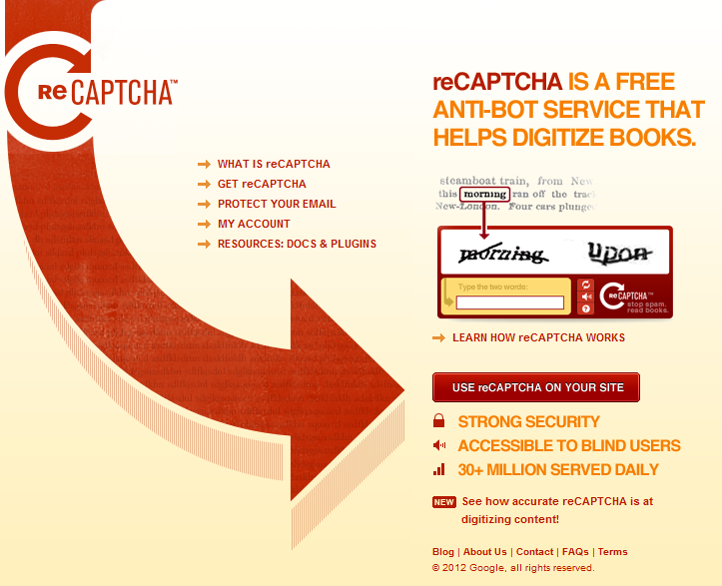

Slide 13
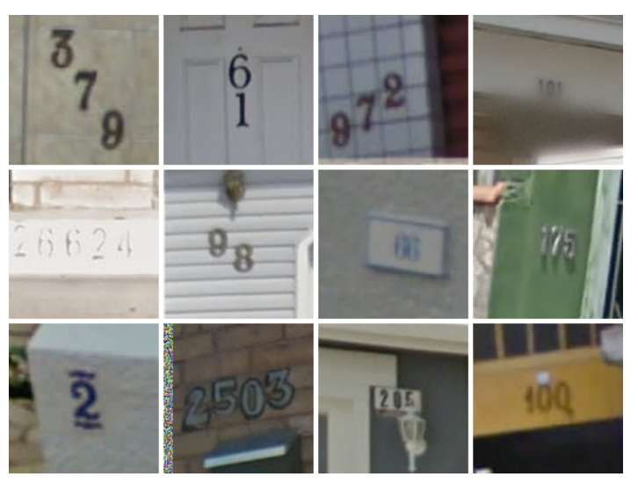
https://www.technologyreview.com/s/523326/how-google-cracked-house-number-identification-in-street-view/

Slide 14
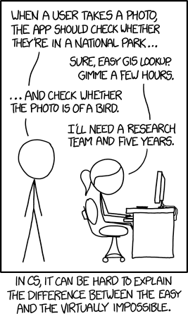
In the 60s, Marvin Minsky assigned a
couple of undergrads to spend the summer
programming a computer to use a camera
to identify objects in a scene. He figured
they'd have the problem solved by the end
of the summer. Half a century later, we're
still working on it.
http://xkcd.com/1425/

Slide 15
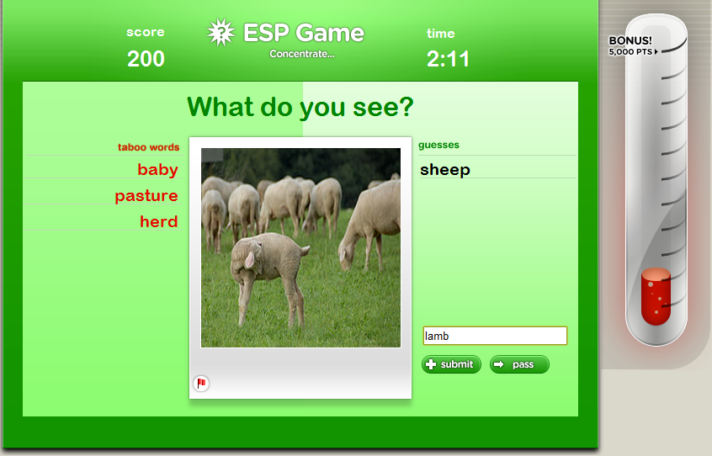
http://en.wikipedia.org/wiki/ESP_game
ESP Game used humans to identify images (shut down in 2011)

Slide 16
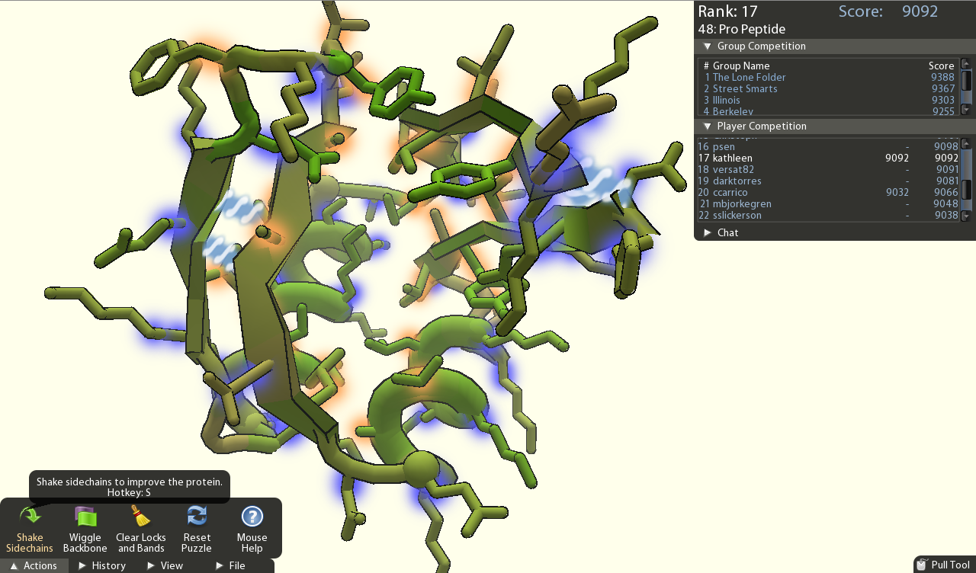
http://fold.it/portal/
“Foldit players folded a protein into a cloud of density. The solutions from Foldit players were better than models produced by expert EM microscopists or automated computer programs.”

Slide 17
CI not superset of HC
Human Computation
HC system could use single person working in isolation
Crowd- sourcing
Social Computing
Collective Intelligence
Data Mining

Slide 18
Crowdsourcing vs. Human Computation
Human Computation
“Whereas human computation replaces computers with humans, crowdsourcing replaces traditional human workers with members of the public.” Quinn and Bedderson, CHI 2011
Crowd- sourcing
Social Computing
Collective Intelligence
Data Mining

Slide 19
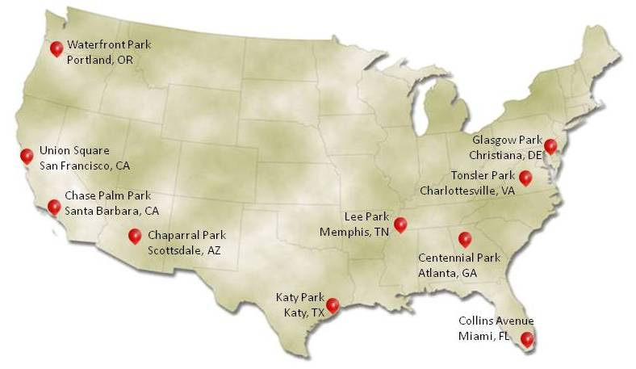
DARPA Network Challenge
Challenge: Find 10 red weather
balloons set up by DARPA, from
10am - 5pm EST, Dec 5, 2009.
They were prepared to run the
challenge for 1 week.
http://en.wikipedia.org/wiki/DARPA_Network_Challenge
MIT placed first (of 10 teams) - found all in less 9 hours
Strategy: Invitation based network (4 initial members), finder gets $2000, with everyone in the invitation network getting 0.5 of the previous amount, remainder donated to charity.

Slide 20
Social Computing
“applications and services that facilitate collective action and social interaction online with rich exchange of multimedia information and evolution of aggregate
knowledge.” Parameswaran and Whinston, Social Computing: An Overview, CAIS 19:37, 2007

Slide 21
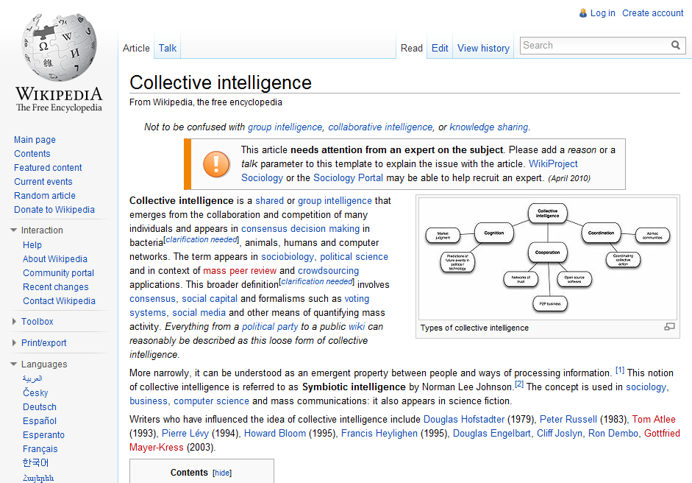

Slide 23
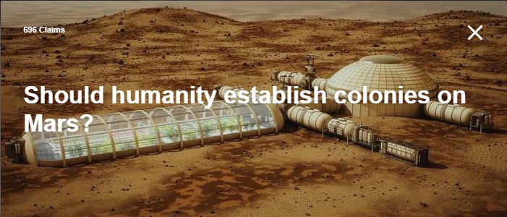
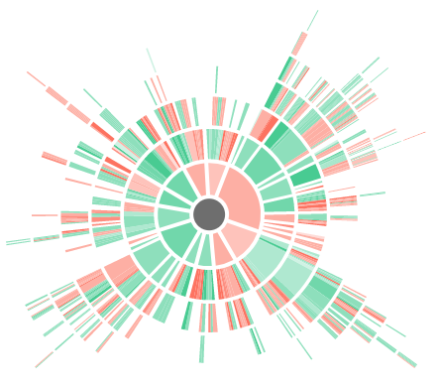
Kialo.com
Online debate platform where users post arguments for and against various issues

Slide 24
Data Mining
“the application of specific algorithms for extracting patterns from data.” Fayyad, Piatetsky-Shapiro, and Smyth,
Knowledge Discovery and Data Mining: Towards a
Unifying Framework, Proc. KDD, 1996

Slide 25
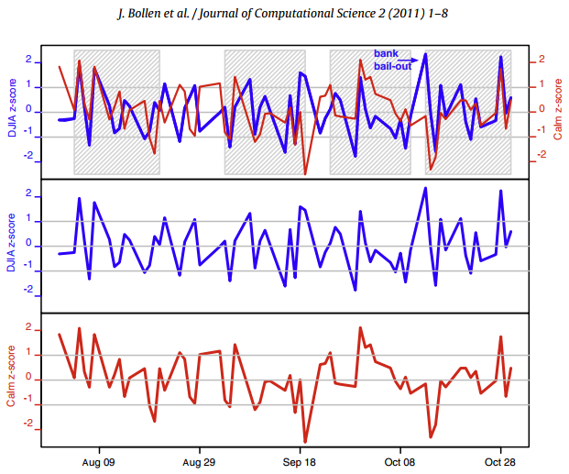
Twitter mood predicts the stock market (Bollen et al., 2011)

Slide 26
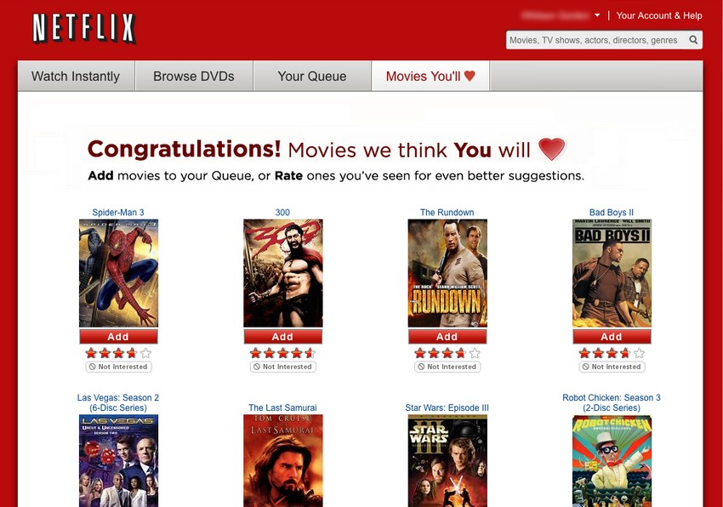
Image: http://lifehacker.com/5642050/five-best-movie-recommendation-services

Slide 27
Summary
Collective intelligence is a relatively new field that makes use of a networked world
Combines
Human computation: Get humans to do what a computer can’t
Crowd sourcing: Involve the general public
Social computing: Grow complex info from public interaction
Data mining: Machine learning and data mining algorithms
Need for ethical standards

Slide 28
Further Reading
Howe, Crowdsourcing (2008)
Marmanis & Babenko, Algorithms of the Intelligent Web (2009)
Segaran, Programming Collective Intelligence (2007)
Shirky, Here Comes Everybody (2009)
Surowiecki, The Wisdom of Crowds (2004)
Tapscott, Wikinomics (2010)

