Slide 1
Document Filtering
Dr. Frank McCown
Intro to Web Science
Harding University
This work is licensed under a Creative Commons Attribution-NonCommercial-ShareAlike 3.0 Unported License

Slide 2
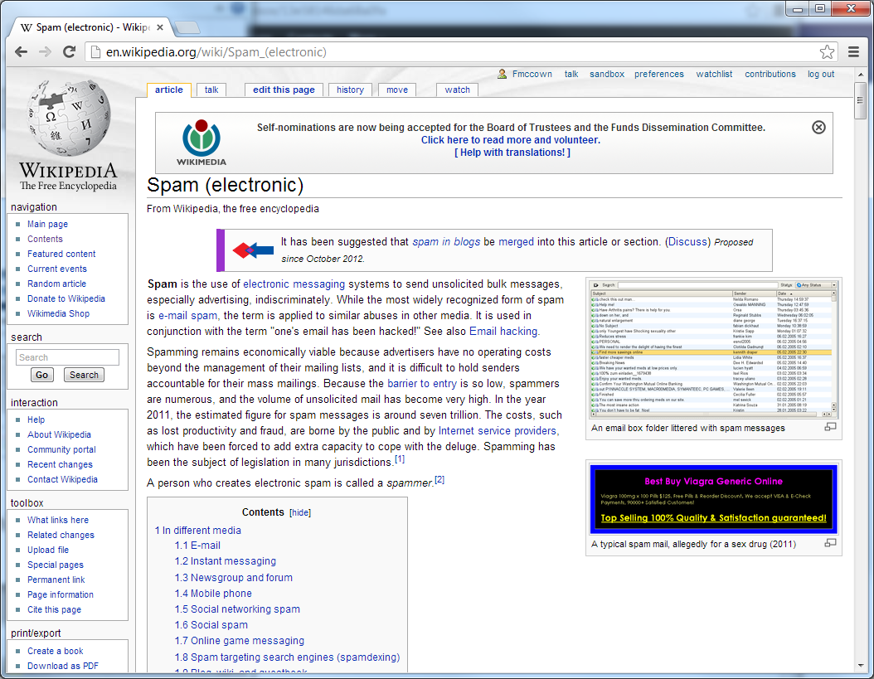
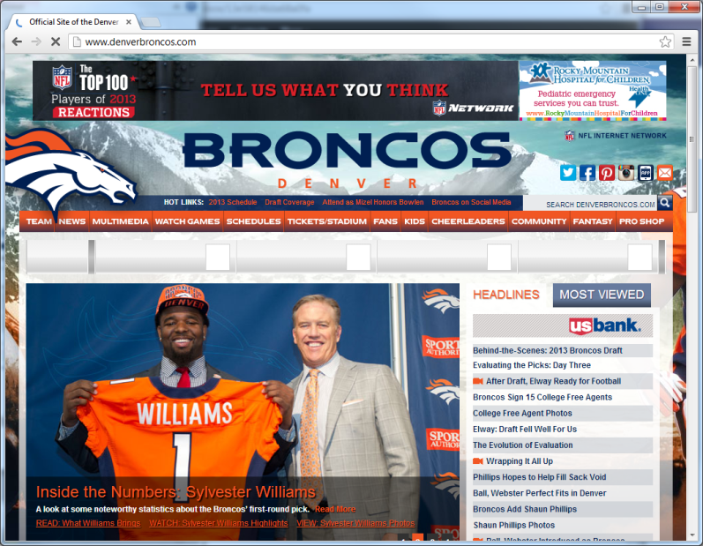
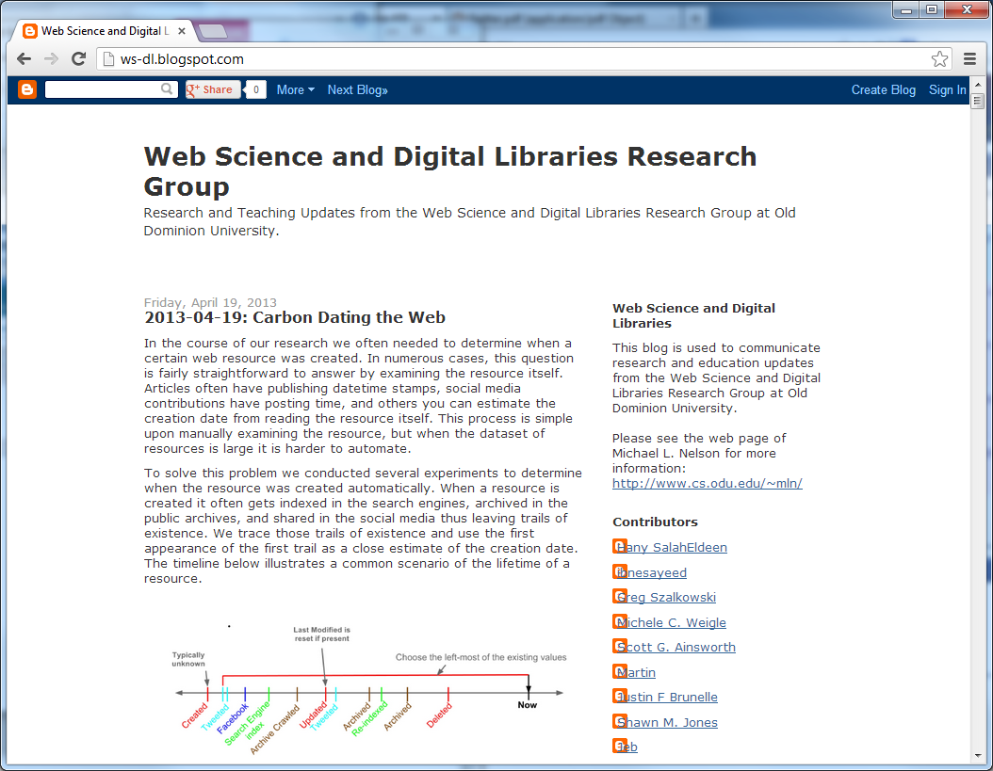
Can we classify these documents?
Science, Leisure, Programming, etc.

Slide 3
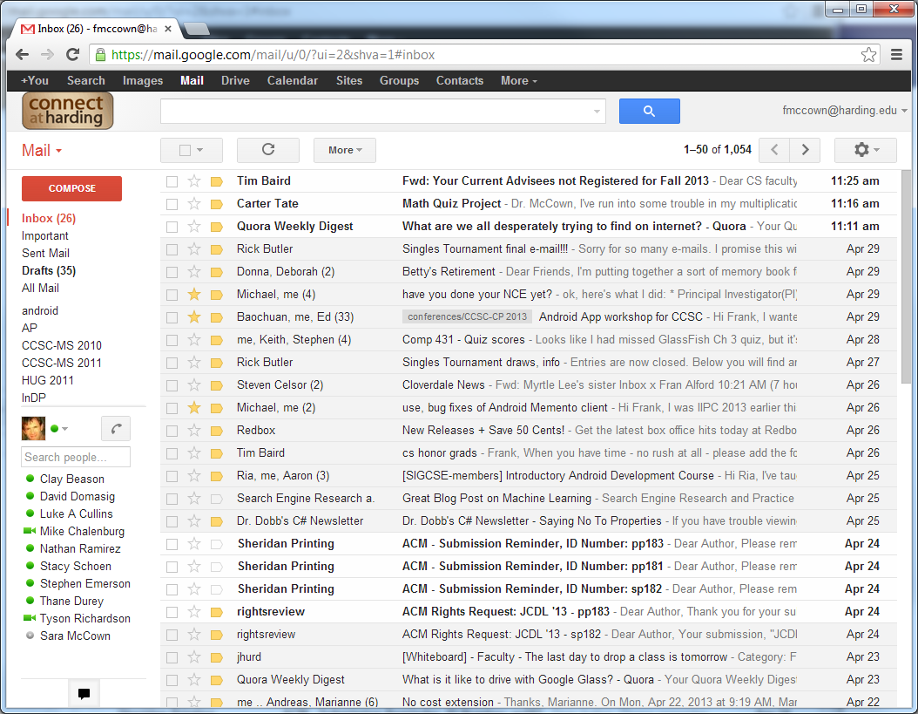
Can we classify these documents?
Important, Work, Personal, Spam, etc.

Slide 4
Features
Many external features can be used depending on type of document
Links pointing in? Links pointing out?
Recipient list? Sender’s email and IP address?
Many internal features
Use of certain words or phrases
Color and sizes of words
Document length
Grammar analysis
We will focus on internal features to build a classifier

Slide 5
Spam
Unsolicited, unwanted, bulk messages sent via electronic messaging systems
Usually advertising or some economic incentive
Many forms: email, forum posts, blog comments, social networking, web pages for search engines, etc.

Slide 6
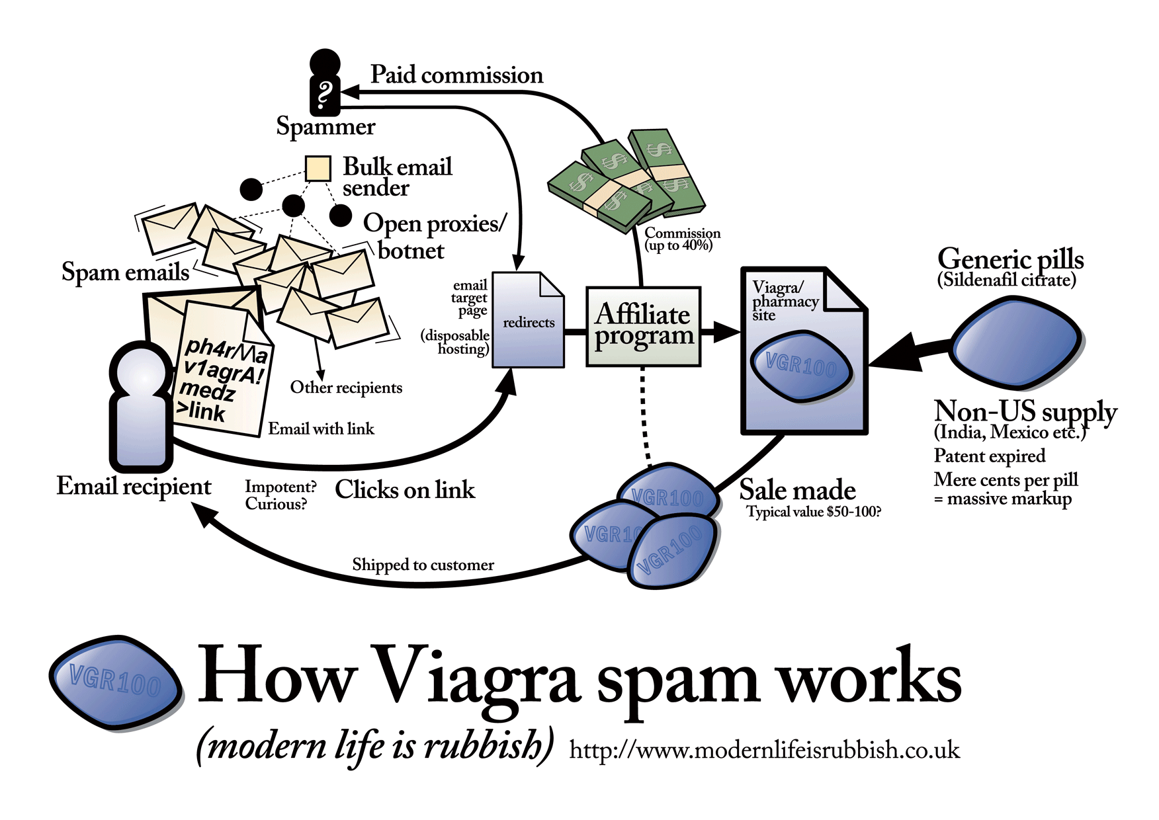
http://modernl.com/images/illustrations/how-viagra-spam-works-large.png

Slide 7
Classifiers
Needs features for classifying documents
Feature is anything you can determine that is present or absent in the item
Best features are common enough to appear frequently but not all the time
Words in document are a useful feature
For spam detection, certain words like viagra usually appear in spam

Slide 8
Training the Classifier
Classifiers learn by being trained – supervised learning
The more examples of documents and their correct classifications it sees, the better it will get
Over time the features which are more important become more clear

Slide 9
Training Examples
“We should watch more” → Good
“Do more good to others” → Good
“Poker, blackjack, and casino” → Bad
“Make more money at the online casino” → Bad
“Watch one more time” → Good
Count number of times each word is present in each category.

Slide 10
Features Set
 | Good | Bad
casino | 0 | 2
money | 0 | 1
more | 3 | 1
watch | 2 | 0

Slide 11
Calculate Probabilities
Calculate the probability each word appearing in a good or bad document
Conditional probability: Pr(A | B)
Probability of A given B
P(word | classification)
For a given classification, what is prob that a particular word appears
Probability of a good doc containing “watch”
Pr(watch | good) = 2/3 = 0.66667
Probability of a bad doc containing “watch”
Pr(watch | bad) = 0/2 = 0

Slide 12
Weighted Probabilities
Problem: If word is not frequently seen, probability will be too harsh
Pr(money | good) = 0/3 = 0
Solution: Use an assumed probability of 0.5 which will change as more documents that contain the word are encountered
If you have reason to think word is spammy to begin with, increase weight
Assign a weight for assumed probability (1 is highest)
Weighted Probability = (weight * assumedProb + count * Pr) / (count + weight)
count = # of times word appeared in good or bad category

Slide 13
Weighted Probabilities
Weighted Probability = (weight * assumedProb + count * Pr) / (count + weight)
Pr_{w}(money | good) before processing any documents with money in it
= (1 * 0.5 + 0 * 0) / (0 + 1)
= 0.5
Pr_{w} (money | good) after processing one document with money in it
= (1 * 0.5 + 1 * 0) / (1 + 1)
= 0.25

Slide 14
Weight Probabilities
 | good | bad | Pr_{w}(g) | Pr_{w}(b)
casino | 0 | 2 | 0.27 | 0.83
money | 0 | 1 | 0.25 | 0.75
more | 3 | 1 | 0.9 | 0.5
watch | 2 | 0 | 0.61 | 0.17

Slide 15
Naïve Bayesian Classifier
Classifier combines probabilities for multiple words to determine classification
Called naïve because probabilities are combined assuming independence
Probability of one word being found in doc totally independent of another word being found
False assumption since word probabilities are often related (money and casino)
Probability calculated is not actual probability but can be compared to probabilities for other categories

Slide 16
Probability of Whole Document
Naïve Bayesian classifier determines probability of entire document being given a classification
Pr(Category | Document)
Assume:
Pr(python | bad) = 0.2
Pr(casino | bad) = 0.8
So Pr(python & casino | bad) = 0.2 * 0.8 = 0.16
This is Pr(Document | Category)
How do we calculate Pr(Category | Document)?

Slide 17
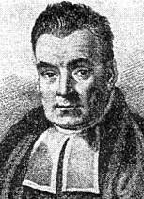
Bayes’ Theorem
Named after British mathematician & Presbyterian minister Thomas Bayes (1700s)
Pr(A | B) = Pr(B | A) * Pr(A)/Pr(B)
Pr(Cat | Doc) = Pr(Doc | Cat) * Pr(Cat) / Pr(Doc)
Where Pr(Cat) = # docs in category / total # docs
Pr(Doc) is usually ignored since it is the same no matter what the category
http://en.wikipedia.org/wiki/Thomas_Bayes

Slide 18
Example with Bayes’ Theorem
Pr(Cat | Doc) = Pr(Doc | Cat) * Pr(Cat)
Pr(good | “more money”)
= Pr(“more money” | good) * Pr(good)
= Pr(more|good) * Pr(money|good) * 3/5
= 0.9 * 0.25 * 0.6
= 0.135
 | good | bad | Pr_{w}(g) | Pr_{w} (b)
casino | 0 | 2 | 0.27 | 0.83
money | 0 | 1 | 0.25 | 0.75
more | 3 | 1 | 0.9 | 0.5
watch | 2 | 0 | 0.61 | 0.17

Slide 19
Example with Bayes’ Theorem
Pr(Cat | Doc) = Pr(Doc | Cat) * Pr(Cat)
Pr(bad | “more money”)
= Pr(“more money” | bad) * Pr(bad)
= Pr(more|bad) * Pr(money|bad) * 2/5
= 0.5 * 0.75 * 0.4
= 0.15
 | good | bad | Pr_{w}(g) | Pr_{w} (b)
casino | 0 | 2 | 0.27 | 0.83
money | 0 | 1 | 0.25 | 0.75
more | 3 | 1 | 0.9 | 0.5
watch | 2 | 0 | 0.61 | 0.17

Slide 20
Example with Bayes’ Theorem
Since Pr(bad| “more money”) > Pr(good| “more money”) document more likely to be spam!
 | good | bad | Pr_{w}(g) | Pr_{w} (b)
casino | 0 | 2 | 0.27 | 0.83
money | 0 | 1 | 0.25 | 0.75
more | 3 | 1 | 0.9 | 0.5
watch | 2 | 0 | 0.61 | 0.17

Slide 21
Choosing a Category
Final step is to determine a category
For spam filter, OK to classify some spam as good, but never want to classify good mail as spam (minimize false positives)
Use thresholds to reduce false positives
Example: Threshold for bad = 3, good = 1
Bad: Bad prob must be 3x good prob
Good: Good prob is anything > bad prob
Unknown: Bad prob < 3x good prob

Slide 22
Choosing a Category
Since we calculated… Pr(good | “more money”) = 0.135 Pr(bad | “more money”) = 0.15
If use threshold bad = 3, good = 1 then…
0.15 < 0.135 × 3 so categorize as Unknown
Therefore best not to label as spam

