Slide 1
Harding University Flying Bison
2010-2011 Preliminary Design Review

Slide 2
Progress and Major Changes
Completed practice launch
New motor selection
Corrected simulations
Improved payload construction
Increased outreach opportunities

Slide 3
Airframe
Vehicle dimensions and layout
Material choices
Motor choice
Expected results

Slide 4
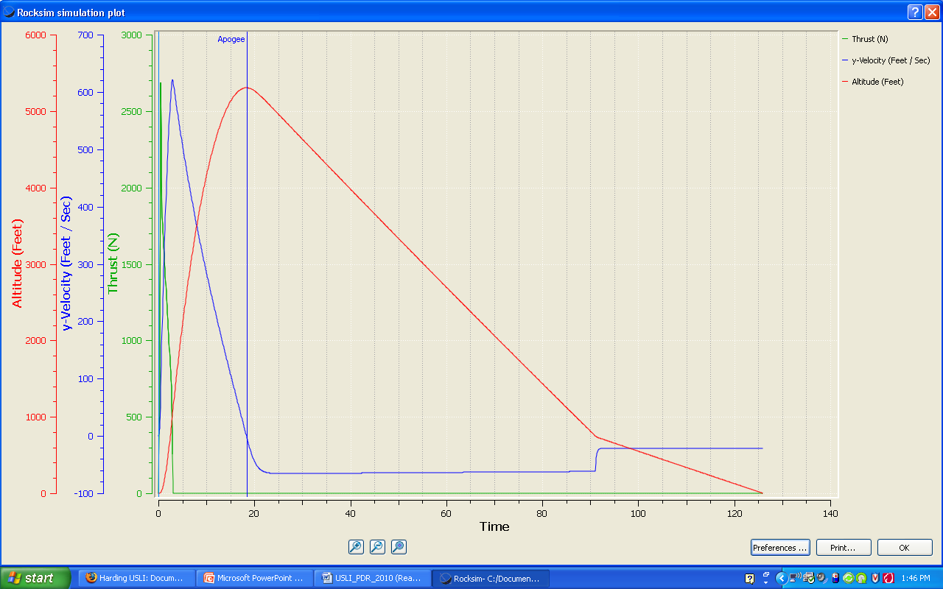
Simulated Flight Data

Slide 5
Payload
Payload overview
Sensor selection
Construction of payload pod
Separating and recovering payload

Slide 6
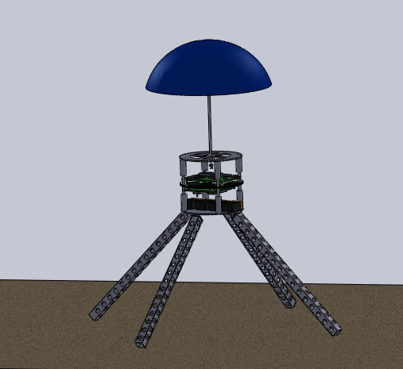
Preliminary Payload Design

Slide 7
Avionics
Hardware selection
Previous and future testing
Separation and recovery plan

Slide 8
Launch Operations
Practice flight
Launch day procedures
Launch system
Safety precautions

Slide 9
Outreach
Current outreach opportunities
Future outreach plans

Slide 10
Plan of Action
Finalize payload design and begin construction
Finalize airframe design and begin construction
Begin launch procedure manual for current project
Continue pushing forward with outreach

