Slide 1
HARDING University
Flying
Bison
A Study of Atmospheric Properties as a Function of Altitude

Slide 2
Major Revisions
Vehicle Changes
Payload Changes
Other changes

Slide 3
Airframe Design
Vehicle dimensions and layout
Material choices
Motor choice
Notes:
Discuss: flight stability in static margin diagram

Slide 4
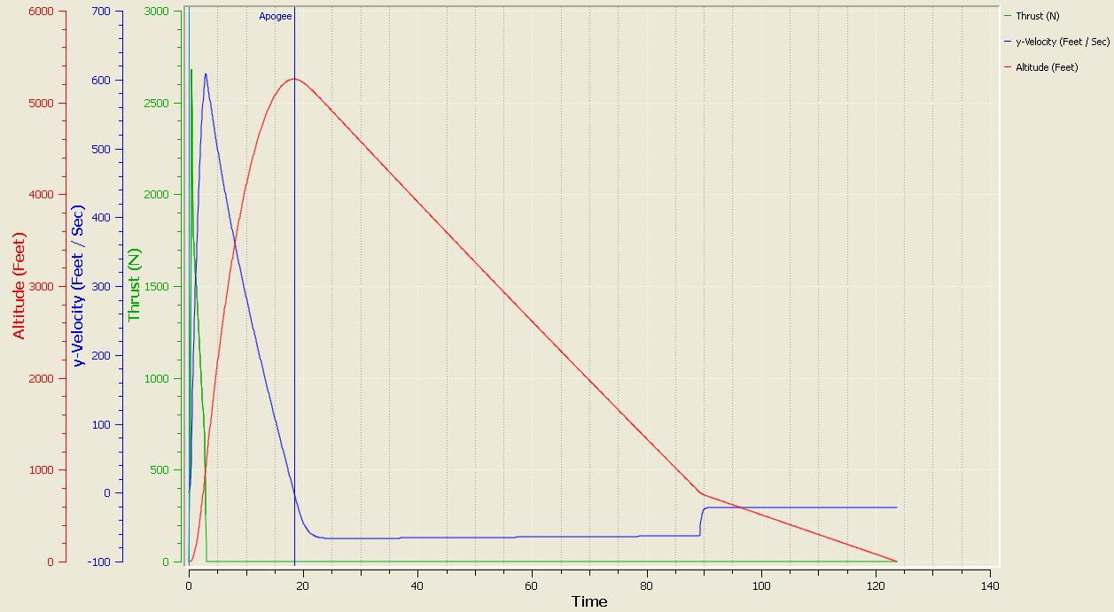
Flight Simulation
-Thrust to weight ratio
-Rail exit velocity
-Descent rates

Slide 5
Avionics
Hardware selection
Previous and future testing
Separation and recovery plan
Notes:
Discuss: parachute sizes and descent rates; Dual deployment avionics test

Slide 6
Payload
Hardware selection
In-flight procedure
Wiring
Testing
Notes:
Discuss payload integration feasibility

Slide 7
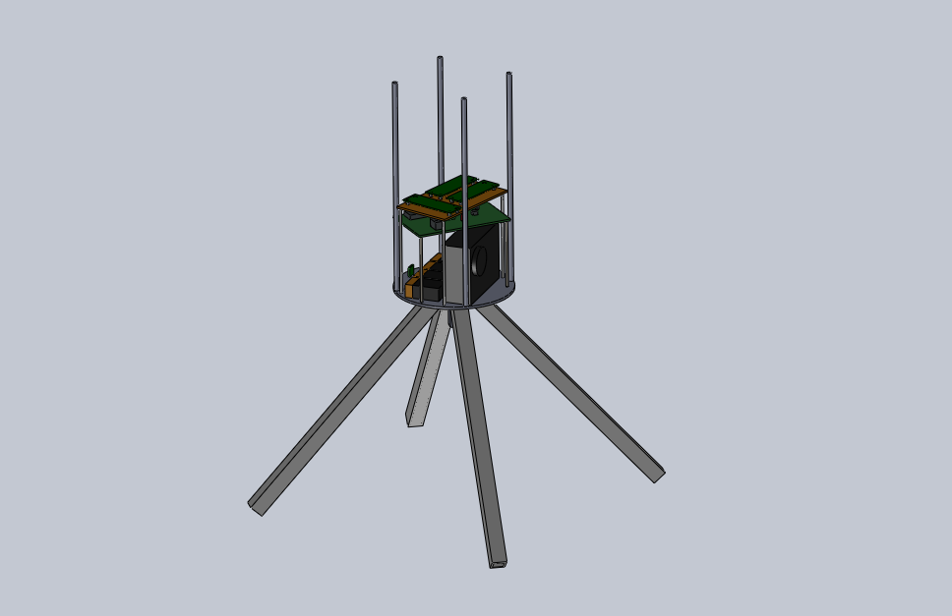
Revised Payload Design

Slide 8
Launch Operations
Scale model flight test
Operational procedure
Safety precautions

Slide 9
Educational Engagement
Current outreach
Future outreach plans
Notes:
Discuss: educational engagement plan and its status

Slide 10
Plan of Action
Begin construction
Component testing
Full scale flight test
Complete FRR
Notes:
Discuss: test plans & procedures; ejection charge amount test

